Slide 1


ARTIFICIAL
INTELLIGENCE
Balancing Innovation and Responsibility

Slide 2

Generative AI – Transforming Industries in 2025
Generative AI is the top AI trend in 2025, creating text, images, code, and videos.
It boosts productivity and innovation across industries like healthcare, finance, and
e-commerce.
However, challenges such as bias, misinformation, and privacy concerns remain.

Slide 3

Arowwai Industries
OUR VISION
“To create intelligent systems that can understand, generate, and collaborate with humans in natural ways — enhancing productivity, driving innovation, and shaping a future where AI acts as a trusted co-pilot across every industry.”

Slide 4

Arowwai Industries
OUR MISSION
1.To empower individuals and organizations by generating content, insights, and solutions.
2.To enhance creativity while reducing time and cost for repetitive work.
3.To ensure responsible and ethical AI use, avoiding bias and misuse.
4.To make AI accessible, scalable, and trustworthy for all sectors.

Slide 5

PROCESS
Collect and train on large datasets using deep learning.
User gives an input or prompt to the model.
The model processes and predicts the best possible response.
AI generates text, images, code, or other outputs

Slide 6
GOALS
To enhance human productivity by automating routine and time-consuming tasks.
To boost creativity and innovation by generating fresh ideas, designs, code, and content.
To support better decision-making through intelligent insights, predictions, and simulations
To deliver personalized experiences, tailoring content and solutions to individual needs.
To promote responsible and ethical AI usage, ensuring fairness and transparency.
To drive industry transformation, enabling businesses to adopt smarter, AI-first strategies for growth.

Slide 7
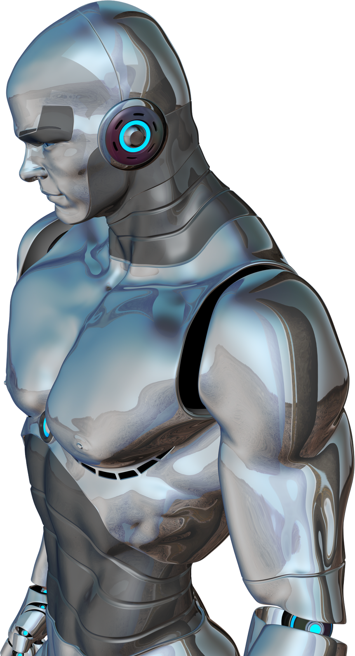
INTELLIGENCE
Intelligence in AI refers to the ability of machines to mimic human thinking and problem-solving.
It involves learning from data, reasoning, understanding patterns, and making decisions.
In Generative AI, intelligence is shown by creating new and original outputs (text, images, code) rather than just repeating data.

Slide 8
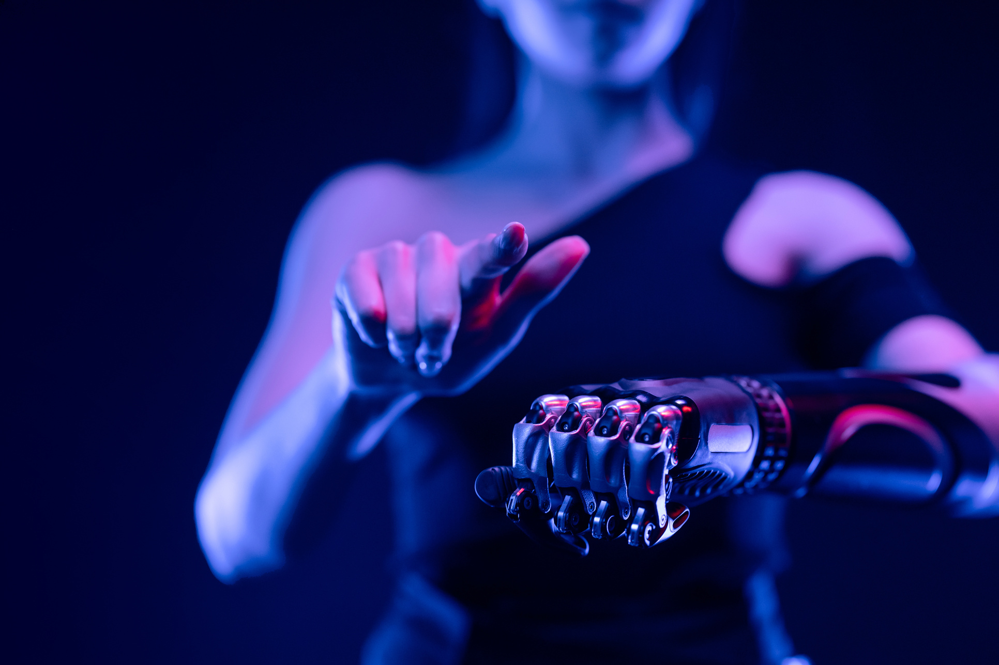
ACHIEVEMENT
Generated human-like text, images, music, and videos that rival creative work.
Powered AI copilots in coding, writing, and design, boosting productivity worldwide.
Adopted across industries like healthcare, finance, education, and e-commerce.

Slide 9
THANK YOU!
FOR YOUR ATTENTION

